Slide 1
Introduction to networking
The lecture 1

Slide 2
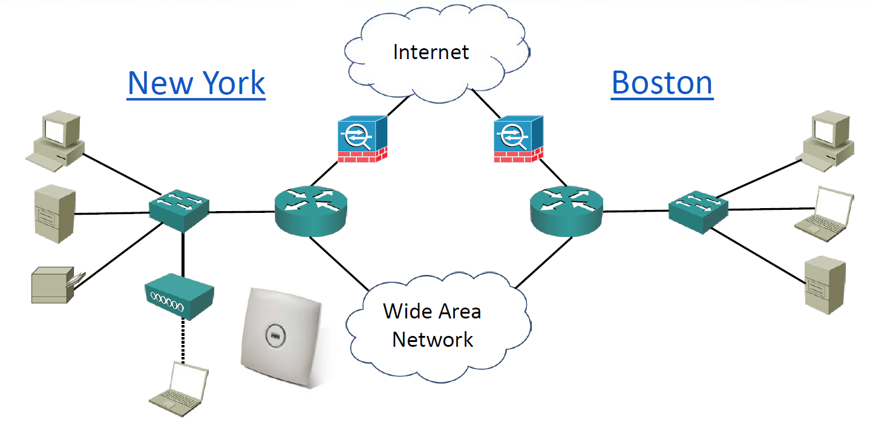
Basic introduction to networking

Slide 3
Network characteristics
Topology
Speed
Cost
Security
Availability
Scalability
Reliability

Slide 4
The OSI Open Systems Interconnect Model

Slide 5
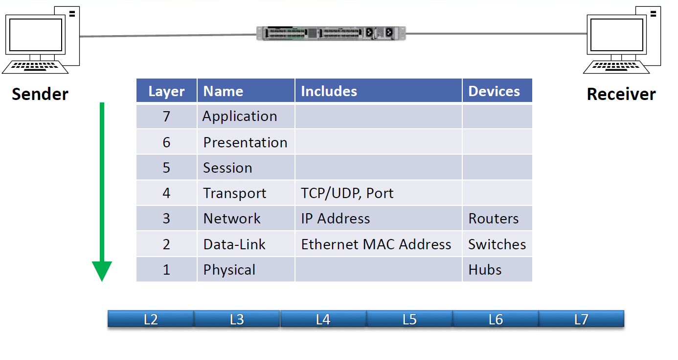
OSI Reference Model -Encapsulation

Slide 6
OSI Model Benefits

Slide 7
The OSI Open Systems Interconnect Model

Slide 8
The TCP/IP Suite

Slide 9
Comparing the OSI Model with the TCP/IP Stack

Slide 10
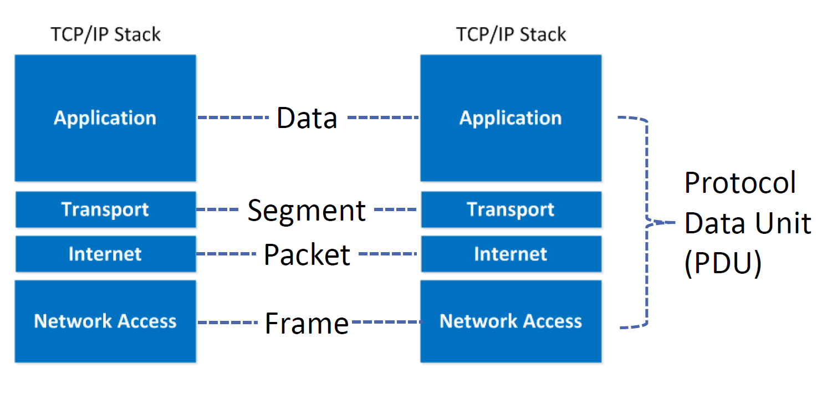
Host Communications Terminology

Slide 11
The Upper OSI Layers

Slide 12
Layer 7 – The Application Layer

Slide 13
Layer 6 – The Presentation Layer

Slide 14
Layer 5 – The Session Layer

Slide 15
The Lower OSI Layers

Slide 16
Layer 4 – The Transport Layer

Slide 17
Layer 3 – The Network Layer

Slide 18
Layer 2 – The Data-Link Layer

Slide 19
Layer 1 – The Physical Layer

